Slide 1
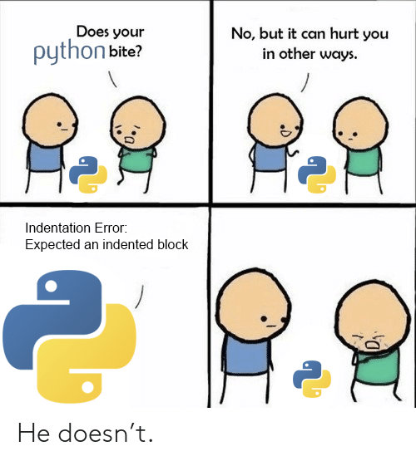
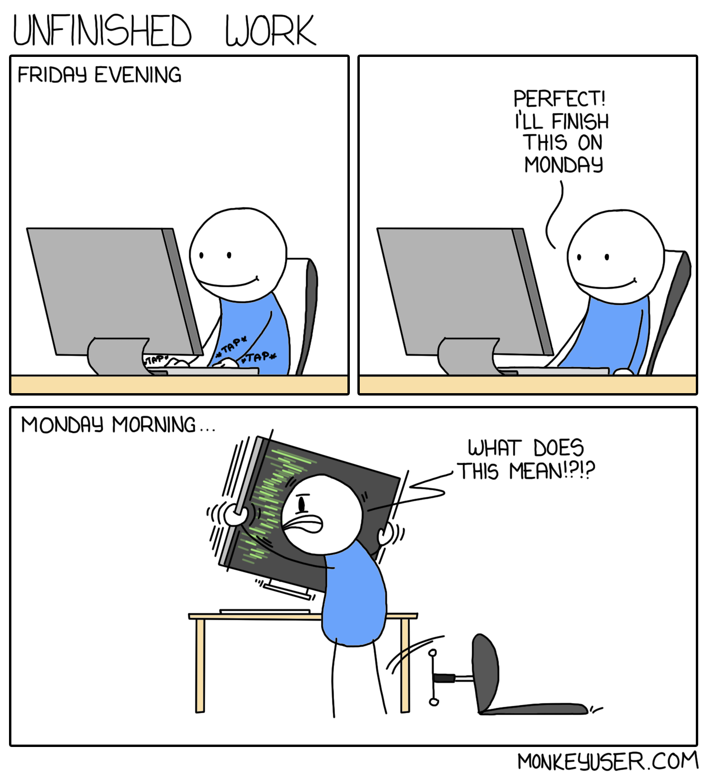
COMP2041
Week 9

Slide 2
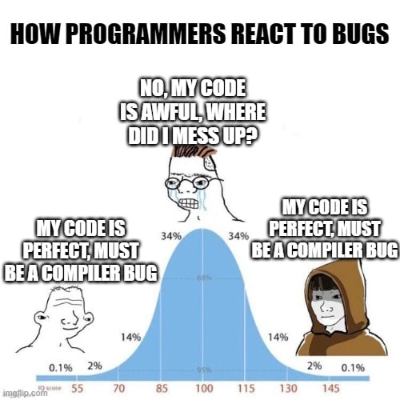
Announcements
Welcome to Week 9 of COMP2041
Week 8 Weekly Test due Thursday 9PM AEST
Week 8 Labs due at 12PM Monday
Ass1 is being marked (I marked you guys already)

Slide 3
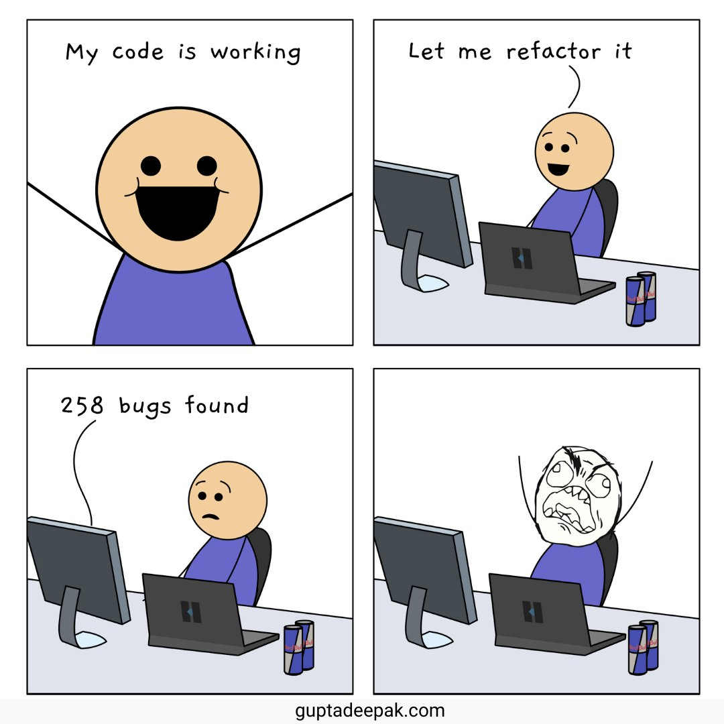
Overview
More Python Programming
Assignment 2
myExperience

Slide 4
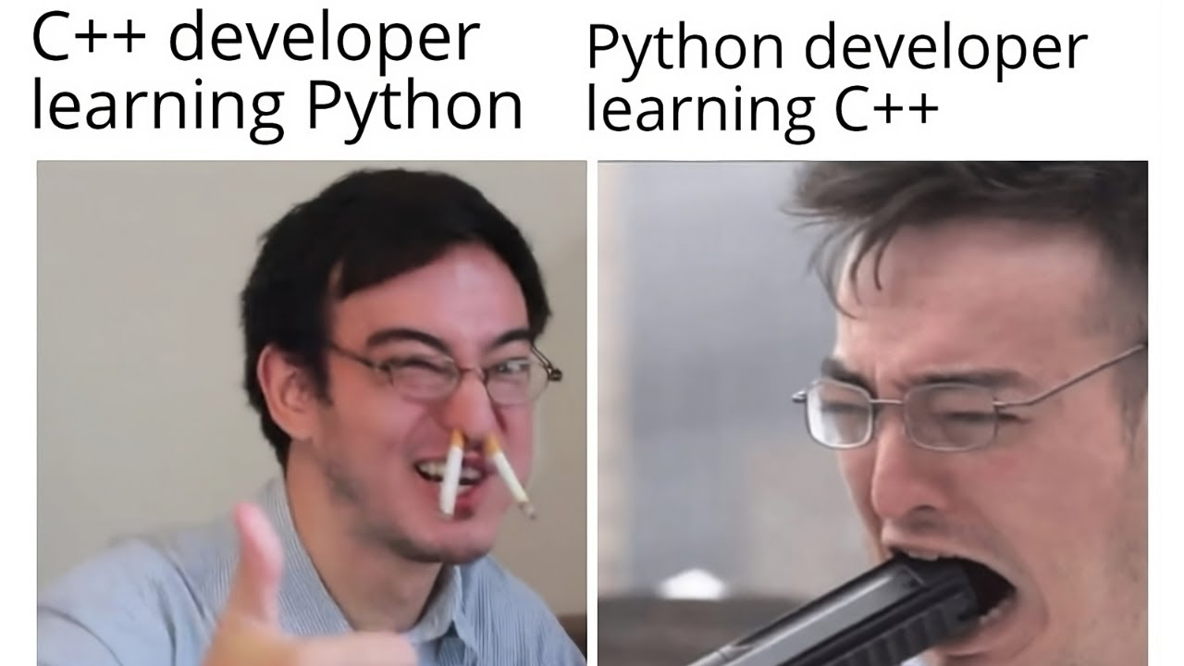
Useful Python stuff
cd: os.chdir('/path/to/directory')
mkdir: os.mkdir('/path/to/directory')
Check directory exists: os.path.isdir('/path/to/directory')
Get current directory: os.getcwd()
Write to file: with open('example.txt', 'w') as file: file.write("Text") file.write(“Overwriting text")
Append to file: with open('example.txt', 'a') as file: file.write("Text appended") file.write(“Text appended again")
Check file exists: os.path.exists(‘example.txt’)
filecmp also useful (https://docs.python.org/3/library/filecmp.html)
Globbing
Subprocesses

Slide 5
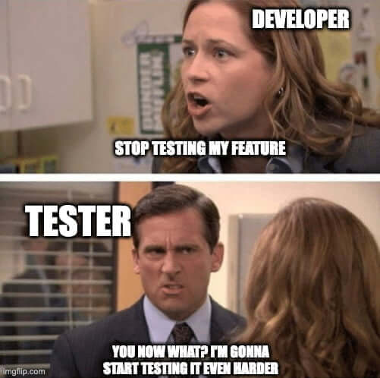
Assignment 2 Style & Tests
Good variable names
Header comments

Slide 6
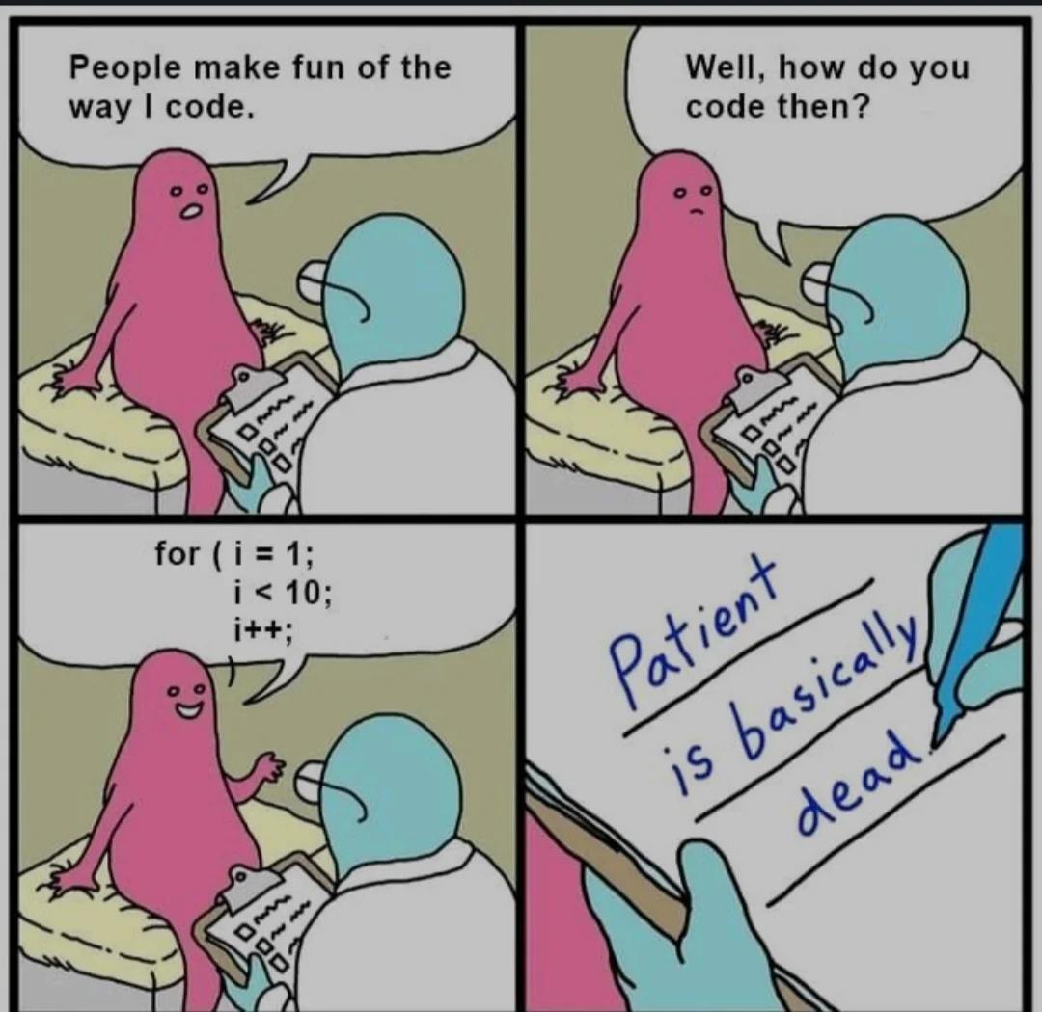
Style & Tests
Don’t do anything stupid
Inconsistent indentations (Tabs of size 4 and 2 mixed)
Inconsistent amounts of newlines
Commenting in another language
Follow style guides from Assignment 1 (Good commenting & Consistency)
Header comments
Commenting before large chunks of code
Descriptive variable names (no magic numbers like a, b, c, i, j, k)
Consistent newlines
Consistent spacing
Consistent tabs
“Will someone else have tremendous difficulty reading your code?”
Test scripts: Do the same thing from assignment 1 (Shell scripting, again)
Everything is the same, just that you’re testing python files instead of shell files

Slide 7
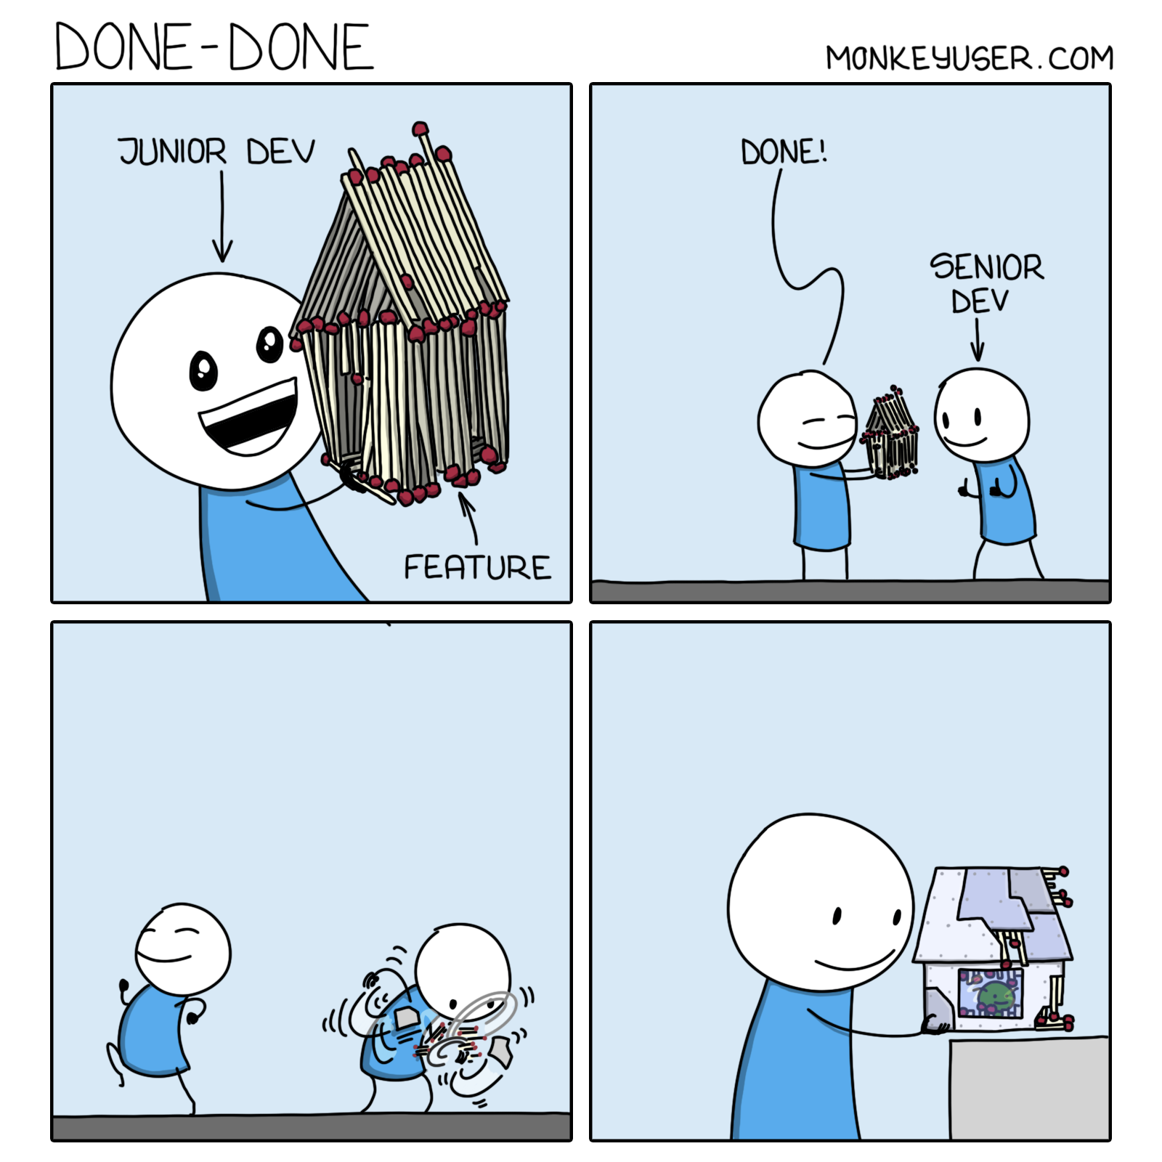
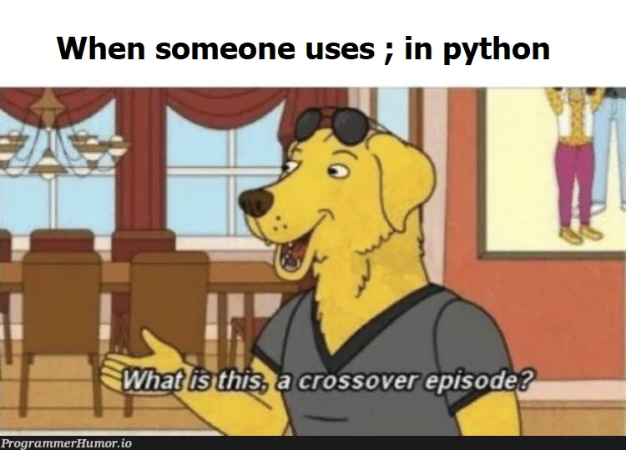
Tutorial Questions

Slide 8

To The
Lab!

